Slide 1

Parrot Post
Group 21

Slide 2
Group Members & Responsibilities
Silas Edrington: Scrum Master
Landon Leigh: General Developer
Timothy Mathis: Back-End Developer
Saim Woldu: Front-End Developer
Matthew Bavis: General Developer, Note Taker

Slide 3
Summary
The end result of this project will be a communication website that allows users to sign in with the domain of their company/organization. Once signed in, the user can view and post announcements, view and post calendar events, view their contacts and each contacts information, view other forms that the domain has uploaded, and view and edit their personal profile and settings.

Slide 4



Platform
The platform that our project is accessible from is any web browser. It is accessible from even the older browsers because everything implemented is compatible.

Slide 5



Tools Used
Marvel - to map out our prototype and give us a starting point of how we want it to look
Webstorm - to program all of our HTML, CSS, and Javascript
GitHub - to share code and all contribute

Slide 6
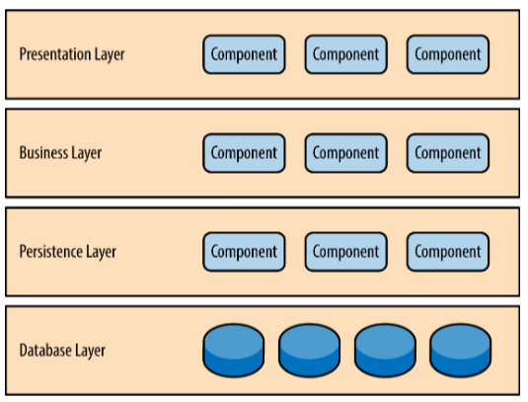
Chosen Architecture
Layered Architecture
Allows ease of development and lets us separate components
User sees presentation layer which consists of html and php files with css editing
User inputs will send down the layers and access the databases that store the login information and posts and calendar events

Slide 7
User Stories
S2-As an organization member I need to be able to view upcoming meetings in a calendar so that users are able to view upcoming events
S4-As an organization member I need to be able to view information about my organization so that viewing important documents like absence forms are needed to properly operate an organization
S8-As an organization member, I would like the layout to be neat and easy to navigate so that if the app is easy to use then a user is more likely to use it
In Progress: 10,11,13
¼ done with user story implementation

Slide 8
Lessons Learned
Time Management
Predicting task complexity
Sticking to Strengths

Slide 9
Demo
https://webpages.uncc.edu/lleigh/4155ProjectGroup21/login.html

